Slide 1
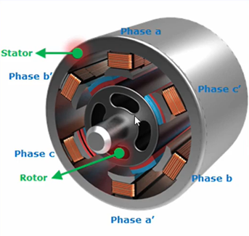

Permanent Magnet Synchronous Motor
Rotor produces constant magnetic field and stator produces rotating magnetic field.
Field coil excited by 3 phase AC supply.
Rotating magnetic field is produced.
Rotor is a Permanent magnet .
Opposite poles of rotating magnetic field and permanent magnet gets
mechanically locked. Synchronous speed can be derived by
Where, NS = speed of rotor in rpm
F = Frequency
P = Number of poles

Slide 2
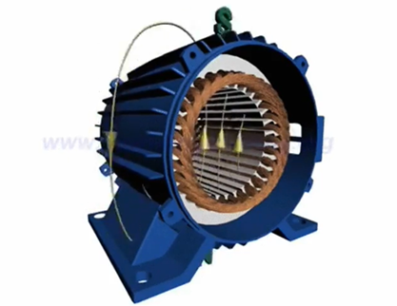

Permanent Magnet Synchronous Motor
Rotor produces constant magnetic field and stator produces rotating magnetic field.
Field coil excited by 3 phase AC supply.
Rotating magnetic field is produced.
Rotor is a Permanent magnet .
Opposite poles of rotating magnetic field and permanent
magnet gets mechanically locked. Synchronous speed can be derived by
Where, NS = speed of rotor in rpm
F = Frequency
P = Number of poles

